Slide 1

BFX-AT100 UHD(4K) Channel Noise
Failure Analysis Report
Prepared by : PE Thuc
Date : 03/01/2023

Slide 2
D1
Establish the Team
Team Leader
Team Member
PE: Michael, Thuc
ME: Cheng Lun, Hugo
PM: An Tran, Yuri
PD: Wen Yong
QA: Ken, Toney
TE: Mark, Jones
IE: Hai Ly, Heng Ruan
Foxconn
  MFG Director: David Yin
  QA Manager : CB Lin, Toney

Slide 3
D2
Problems description -1
Issue Description ( 5W2H)
When | 2022/12/28
Who | ALT customer
Where | SK networks warehouse, Anseong, Korea.
What | ALT customer feedback that they found out 1/1600pcs has UHD(4K) Channel noise. Defect rate: 1/1600 = 625 DPPM
Why | Follow SoC material (P/N: 002.02753.005. DC: 2221. LC: PRK086.00, Vendor: AMLOGIC)
How | UHD(4K) Channel noise
How many | Total 1pcs (Defect rate: 1/1600 = 625 DPPM) as below table.
No | Description Issue | S/N | MAC | Fail rate
1 | UHD(4K) Channel noise | 2149688001202201458214 | 38D57ADDEC53 | 625 DPPM

Slide 4
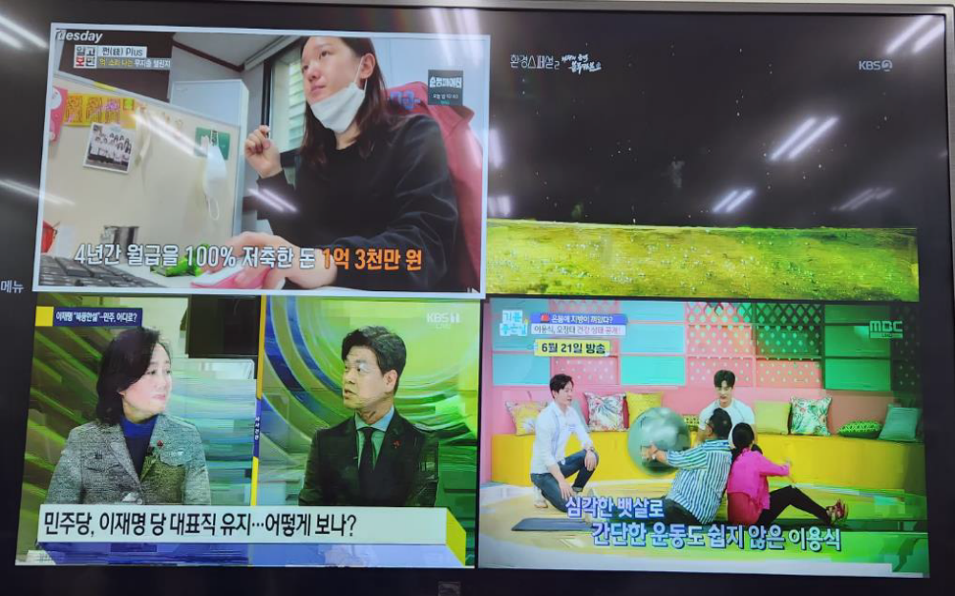
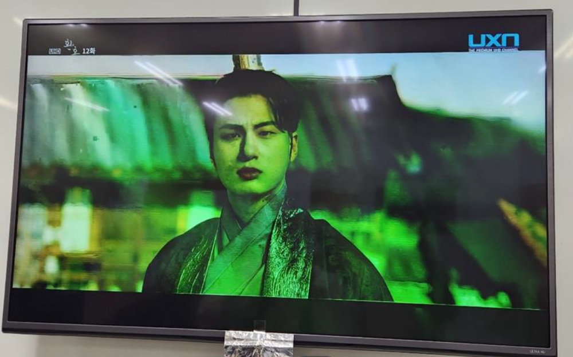
D2
Problems description -2
Multi view channel screen broken or noise
UHD channel broken or noise
Summary:
- UHD channel and multi view channel have unusual color and noise.

Slide 5
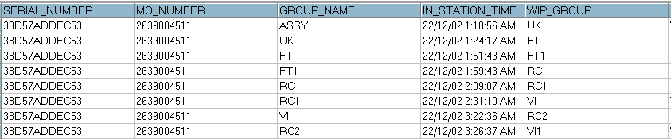
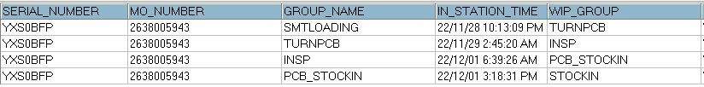
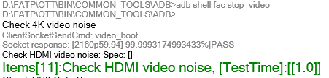
D3
Containment
1. Recheck production data record.
2. Recheck test log
Dot level
T level
No# | Station | Status
1 | UK | PASS
2 | FT (test HDMI video noise) | PASS
3 | FT1 | PASS
4 | RC | PASS
5 | RC1 | PASS
6 | RC2 | PASS
HDMI video noise test Pass at FT station
Summary:
- Recheck production data record and test log ➔ Did not find out any abnormal.

Slide 6
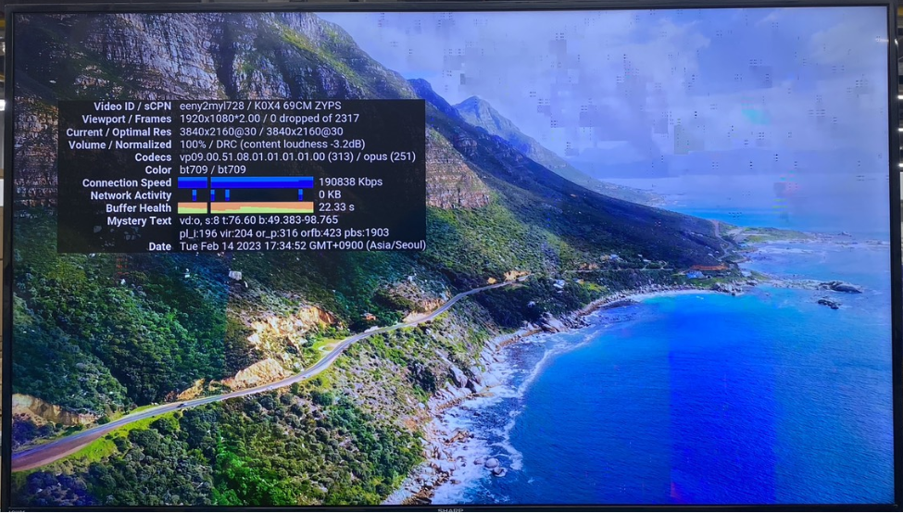
D4
Root Cause: Retest OBA function
1. Retest NG sample at OBA station, the fail symptom same as customer feedback.
Error image when retest 4K video at OBA
Summary: Retest 4K video function on YouTube → Occur blue streaks, noise and splashes on the screen.

Slide 7
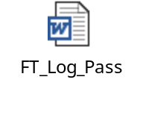
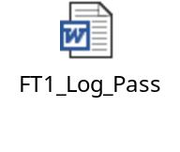
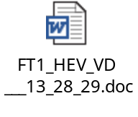
D4
Root Cause: Retest FATP
2. Retest NG sample at FT, FT1 station using old test program on 03.01, the result as below:
No. | Station | Log test | Result
1 | FT |  | Pass
2 | FT1 |  | Pass
3. Retest NG sample at FT1 station after updating new test program on 03.09, the result as below:
No. | Station | Log test | Result
1 | FT1 |  | Fail
Summary:
- Retest NG sample at FT1 station by old test program ➔ Pass normally.
- Retest NG sample at FT1 station by new test program ➔ Check video HDMI HEVC video fail
➔ New test program(03092023) at FT1 station can cover this issue

Slide 8
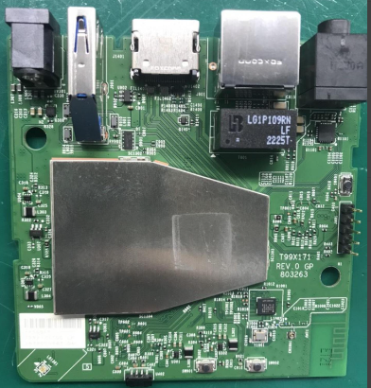
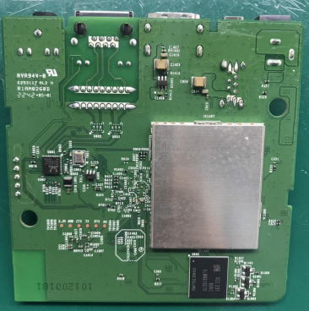
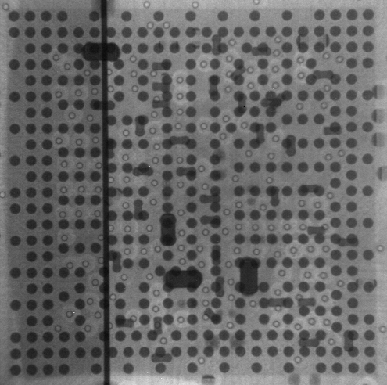
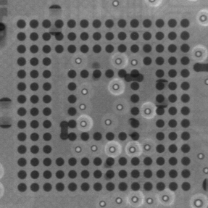
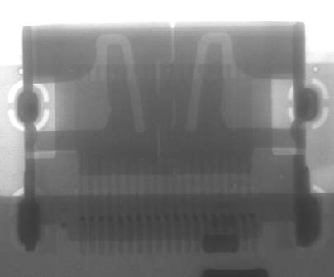
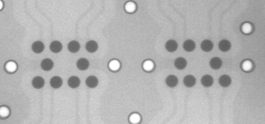
D4
Root Cause: Visual Inspection and Take X-ray
4. Check Visual inspection and take X-ray NG sample, result as below:
Item | Top side | Bottom side | Result
Visual inspection |  |  | No abnormality
Item | SoC | eMMC | HDMI Connector | Filter | Result
X-ray |  |  |  |  | No abnormality
Summary:
- Check visual inspection and take X-ray ➔ Result: No abnormality

Slide 9
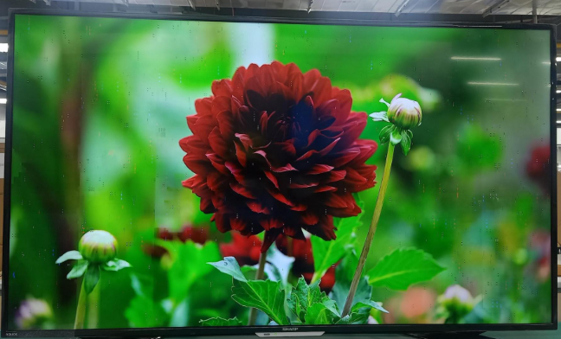
D4
Root Cause: Retest OBA after Baking
5. Retest 4K video function after baking PCBA (45⁰ in 12hrs) result as below:
Occur noise and splashes on the screen
Summary:
- Retest NG sample at OBA after bake PCBA ➔ Result: Fail symptom like the original symptom .

Slide 10
D4
Root Cause: Impedance/VF Measurement
6. Measure impedance /VF on board HDMI connector of NG sample and compare with OK sample, result as table below:
Impedance/VF measurement on board HDMI Connector
Pin No | Pin Name | Description | NG sample |  | OK sample
 |  |  | Impedance (Ω) | VF | Impedance (Ω) | VF
1 | TX2+ | HDMI TMDS data2 negative output | 3.1M | 0.68 | 3.2M | 0.68
2 | TX2_shield | System Ground | 0 | 0 | 0 | 0
3 | TX2- | HDMI TMDS data2 positive output | 3.1M | 0.67 | 3.2M | 0.68
4 | TX1+ | HDMI TMDS data1 positive output | 3.1M | 0.67 | 3.2M | 0.68
5 | TX1_shield | System Ground | 0 | 0 | 0 | 0
6 | TX1- | HDMI TMDS data1 negative output | 3.1M | 0.64 | 3.2M | 0.68
7 | TX0+ | HDMI TMDS data0 positive output | 3.1M | 0.68 | 3.2M | 0.68
8 | TX0_shield | System Ground | 0 | 0 | 0 | 0
9 | TX0- | HDMI TMDS data0 negative output | 3.1M | 0.67 | 3.2M | 0.68
10 | TXC+ | HDMI TMDS clock positive output | 3.1M | 0.67 | 3.2M | 0.68
11 | TXC_shield | System Ground | 0 | 0 | 0 | 0
12 | TXC- | HDMI TMDS clock negative output | 3.1M | 0.68 | 3.2M | 0.68
13 | CEC | General purpose input/output bank H signal 3 | 2.0M | 0.69 | 2.2M | 0.69
14 | NC | Not Connect | NA | NA | NA | NA
15 | SCL | General purpose input/output bank H signal 1 | 1.03M | 0.6 | 1.2M | 0.62
16 | SDA | General purpose input/output bank H signal 0 | 0.97M | 0.6 | 1.01M | 0.61
17 | GND | System Ground | 0 | 0 | 0 | 0
18 | 5V | HDMI_PW | 1.0M | 0.49 | 1.2M | 0.55
19 | HPD | General purpose input/output bank H signal 2 | 109.6K | 0.69 | 110K | 0.69
Summary: Did not find out abnormal with impedance of NG sample

Slide 11
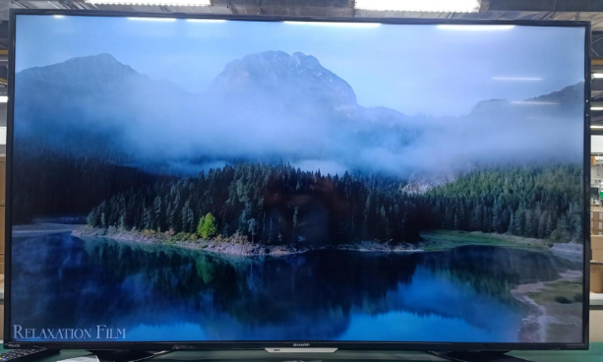
D4
Root Cause: Change Component of HDMI Block
7. Change component of HDMI block:
- Change new FIL1401, FIL1402, J1401 then retest 4K video function
Result: Fail (Occur noise and splashes on the screen)
- Change new SoC and retest 4K video function ➔ Result: Pass (no noise and splashes on the screen)
No noise and splashes on the screen
Summary: After change new SoC then retest 4K video function ➔ Result: Pass (no noise and splashes on the screen)

Slide 12
D4
Root Cause: Thermal Shock Experiment
8. Do thermal shock experiment NG board + OK SoC.
- Condition: Power off, non-operation; Ta = -20ºC (30min) ~ 70ºC (30min); 15 cycles; Transfer time: 5min
- After do thermal shock experiment, retest 4K video function at OBA station ➔ Result: Pass
No noise and splashes on the screen
Summary: Retest 4K video function at OBA after do thermal shock experiment ➔ Result: Pass

Slide 13
D4
Root Cause: Impedance measurement NG SoC
9. Removed SoC and measure HDMI block pin, result as table below:
SoC U1 HDMI pin impedance measurement
U1_PIN NAME | Description | OK Sample |  | NG sample
 |  | Impedance | VF | Impedance | VF
C43 | HDMI TMDS data2 negative output | 8.81MΩ | 0.76 | 9.09M | 0.77
C45 | HDMI TMDS data2 positive output | 8.71MΩ | 0.76 | 8.96M | 0.77
E45 | HDMI TMDS data1 positive output | 8.61MΩ | 0.76 | 8.88M | 0.77
G43 | HDMI TMDS data1 negative output | 8.61MΩ | 0.76 | 9.03M | 0.77
J41 | HDMI TMDS data0 positive output | 8.65MΩ | 0.76 | 8.93M | 0.77
J43 | HDMI TMDS data0 negative output | 8.63MΩ | 0.76 | 9.1M | 0.77
L43 | HDMI TMDS clock positive output | 8.54MΩ | 0.76 | 9.1M | 0.77
L45 | HDMI TMDS clock negative output | 8.64MΩ | 0.76 | 8.99M | 0.77
N41 | General purpose input/output bank H signal 1 | 2.52MΩ | 0.71 | 2.54M | 0.72
N43 | General purpose input/output bank H signal 3 | 2.64MΩ | 0.75 | 2.54M | 0.75
R43 | General purpose input/output bank H signal 0 | 2.49MΩ | 0.71 | 2.536M | 0.72
R45 | General purpose input/output bank H signal 2 | 2.61MΩ | 0.74 | 2.498M | 0.73
AG45 | General purpose input/output bank H signal 4 | 2.91M | 0.78 | 3M | 0.79
Summary: Measure impedance/VF HDMI pins of NG SoC ➔ Did not find out any abnormality

Slide 14
D4
Root Cause: Swap Verification SoC
10. Reball and do a swap verification SoC
Watch 4K video function on youtube | 1 | 2 | 3 | 4 | 5
OK board + OK SoC | OK | OK | OK | OK | OK
NG board + NG SoC | NG | NG | NG | NG | NG
OK board + NG SoC | NG | NG | NG | NG | NG
NG broad + OK SoC | OK | OK | OK | OK | OK
Summary: As analyzed above this issue follow U1-SoC ( P/N: 002.2753.005 ) component

Slide 15
D4
Root Cause: Summary
Root Cause Summary
UHD(4K) Channel noise caused by U1-SoC material issue.
P/N: 002.02753.005
Vendor: AMLOGIC
D/C: 2221, L/C: PRK086.00

Slide 16
D5
Corrective Action
Short term:
- Increase OBA checking rate from AQL ~ 0.65 to AQL ~ 0.4 , Owner : Ken , due date : 03/04
- Co-work with RD team , how to use SW to cover this issue at FATP , Owner : RD Sean , status: Done
- Verify new test program by used golden sample video (03092023) which can cover this issue on FATP . Owner TE. Mark , status: Done
Long term:
- Send the NG SoC material to vendor AMLOGIC for FA. Owner. SQE. Naomi , Due date: Q2/2023.

